Slide 1
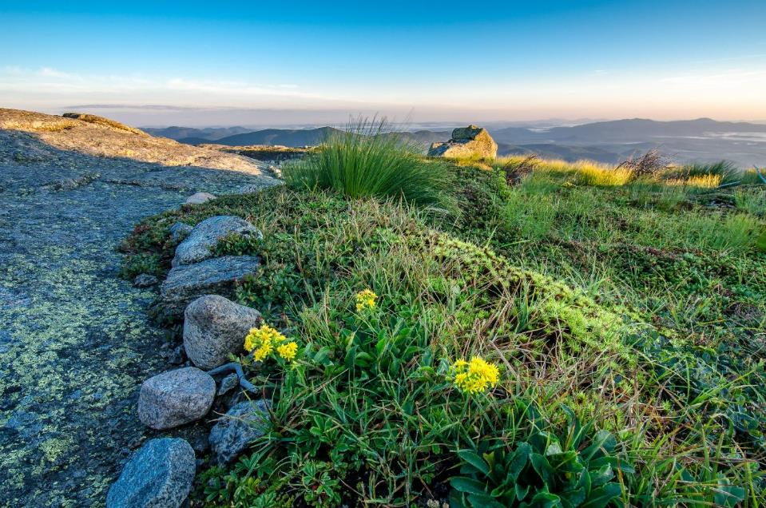
Photopoint Monitoring in the Adirondack Alpine
Julia Goren
Adirondack High Peaks Summit Steward Program

Slide 2
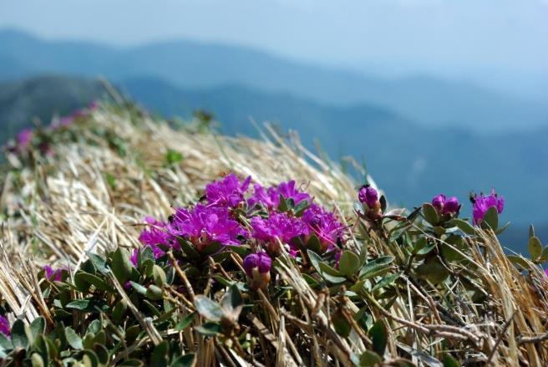
Alpine zone
Area above the treeline where specially adapted arctic tundra plants are found

Slide 3
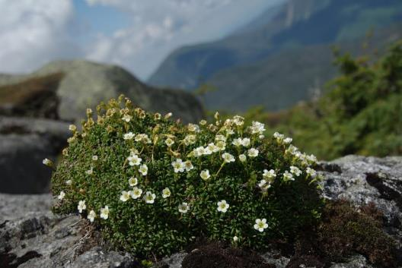
Adirondack alpine zone
Approximately 170 acres of alpine habitat
Alpine vegetation spread over 21 summits, concentrated on 6 peaks
Approximately 30 rare/ threatened/ endangered species
Photo: Seth Jones
Notes:
Marcy, Algonquin, Haystack, Skylight,

Slide 4
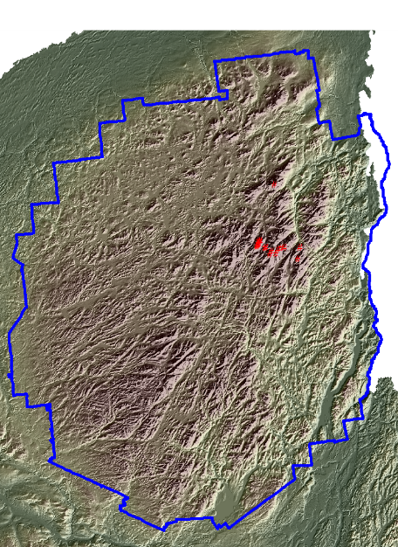
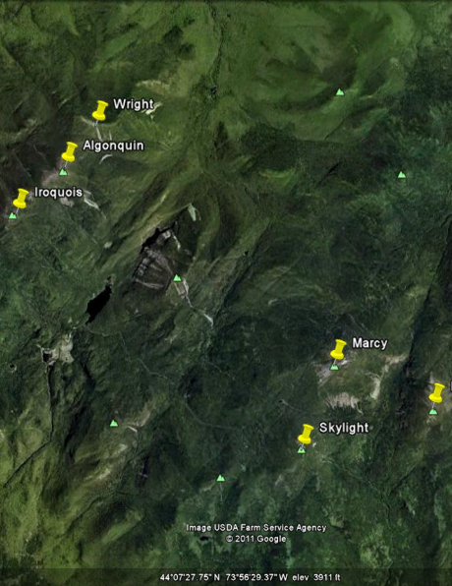

Slide 5
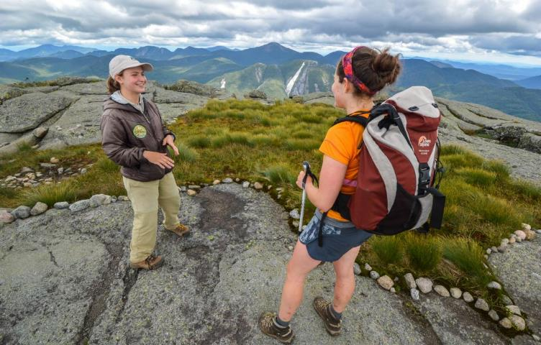

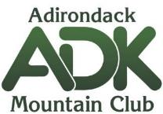

The Summit Steward Program
Notes:
A little bit about who we are: The Summit Steward program is a 22 year partnership of ADK, TNC, DEC. Our mission is to help protect NY’s alpine

Slide 6
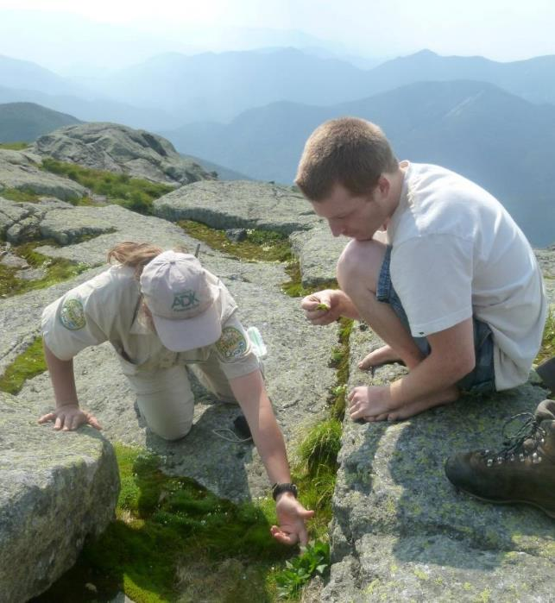
Education
Notes:
We do this through education (most important!), trail work, and research

Slide 7
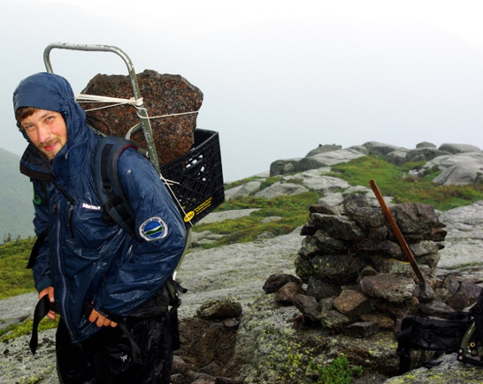
Trail work

Slide 8
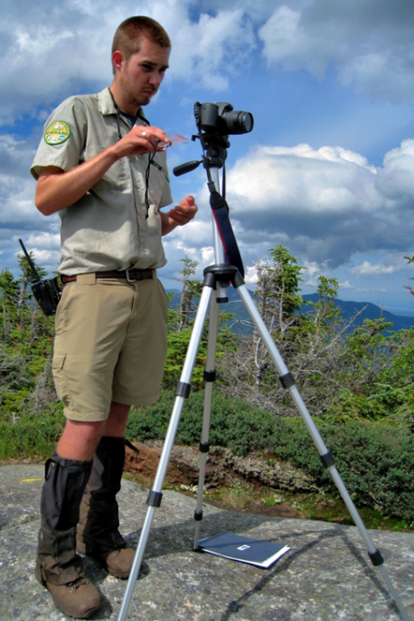
Research

Slide 9
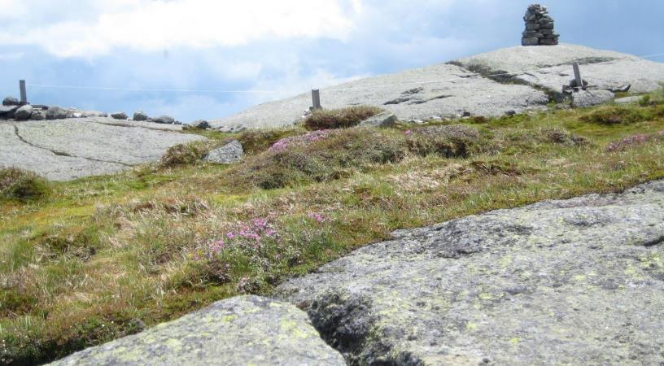
Photopoint Monitoring
Photopoints are photographs of a landscape area taken repeatedly from the same exact position, showing qualitative changes over a set time.
Notes:
Photopoint monitoring represents a long-term data set that illustrates rates of trampling, erosion, and vegetative re-growth

Slide 10
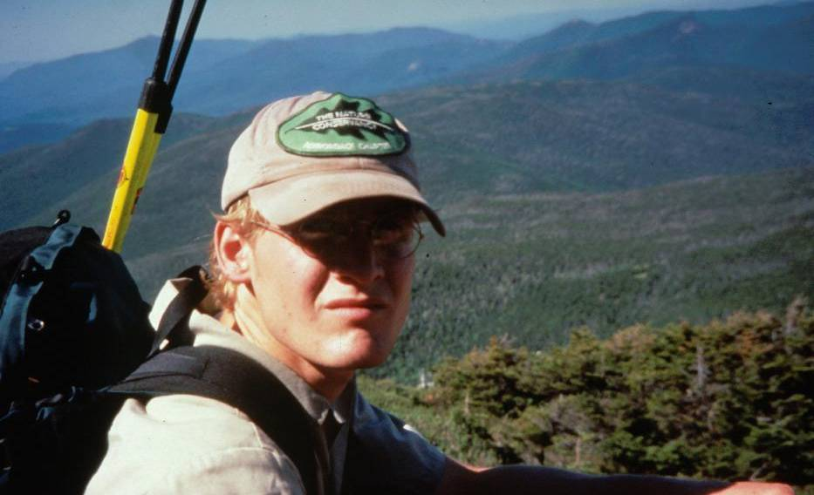
Photopoint Monitoring
Notes:
Our photopoint monitoring project was Established in 1999 by Matt Scott to document health of the alpine communities and evaluate the Summit Steward program’s effectiveness
Matt Scott used baseline photographs from Dr. Ketchledge’s historical photograph collection
He and Ketch selected areas to rephotograph
Scott replicated the photographs as closely as possible, drilling nails into the rock and notating tripod height and camera angle to allow for exact replication

Slide 11
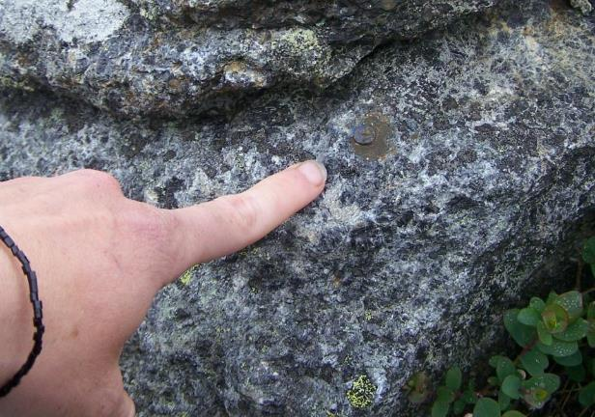
Photopoint Monitoring Methods
59 photopoints spread over 9 summits, retake cycle determined by impact
Notes:
We now have 50 photopoints on 9 summits. The retake cycle for photographs is determined by level of impact and likelihood of change. Some photos are retaken every 2 years, some every 5, some 10

Slide 12
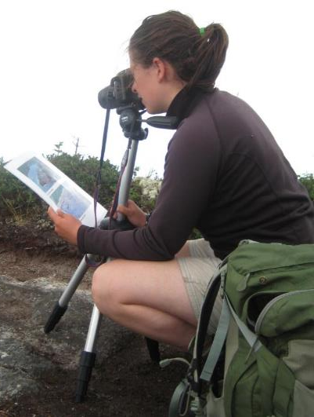
Photopoint Monitoring Methods
Photopoints are relocated, using a combination of GPS unit, map, directions, and prints of prior photographs.
The same camera was used in 1999, 2004, 2009, 2011, and 2015 to minimize possible distortion resulting from lens curvature.
Notes:
Photopoints were set up in 1999, retaken in 2004 with funding assistance from the Waterman Fund, 2007, 2008, 2009, 2010, 2011
Once we find the nail, which usually requires a combination of the sketch map and directions, prints of prior photos, and a bit of a scavenger hunt, we set up the tripod and camera to specified height, angle, and direction.
While we use the same film camera that was used by Matt Scott in 1999 to avoid distortion, we also use a digital camera to allow for a quick field check of images.

Slide 13
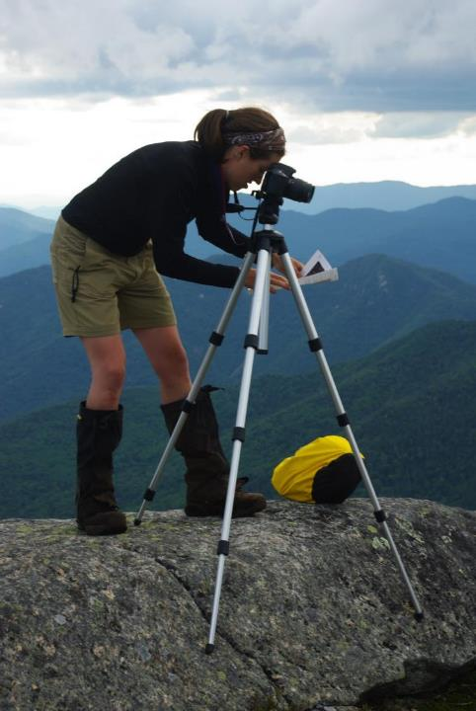
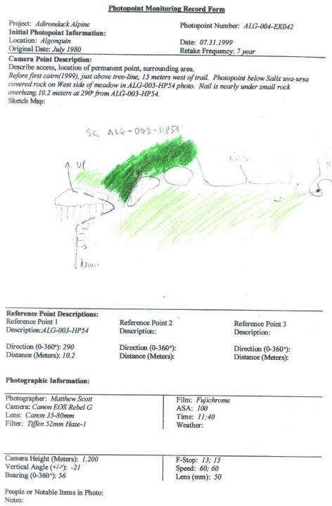
Photo: Seth Jones
Notes:
Left: Summit Steward Lynn Metcalf compares the view in front of her with a print of an earlier photopoint to properly line up the image. Right: Photopoint monitoring field form

Slide 14
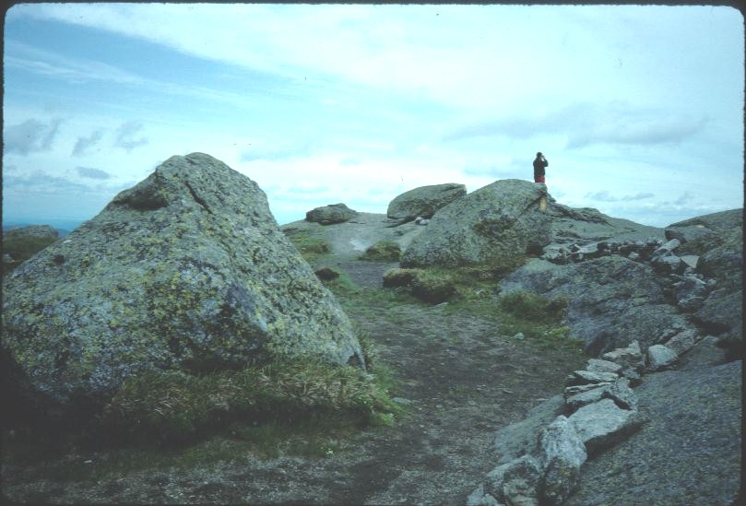
Example Photopoint: MAR-003-LB001-1992
Notes:
And I’d just like to show you an example photopoint. This is from Mt. Marcy, the highest peak in the Adirondacks. This is from 1992

Slide 15
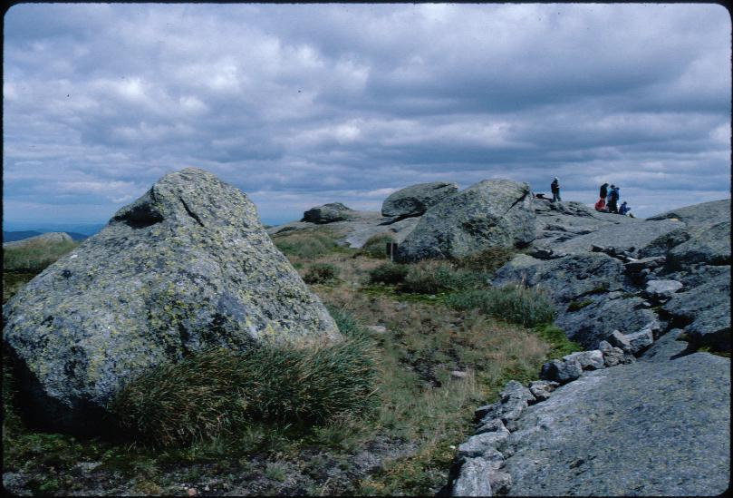
Example Photopoint: MAR-003-LB001-1999
Notes:
Same area 1999

Slide 16
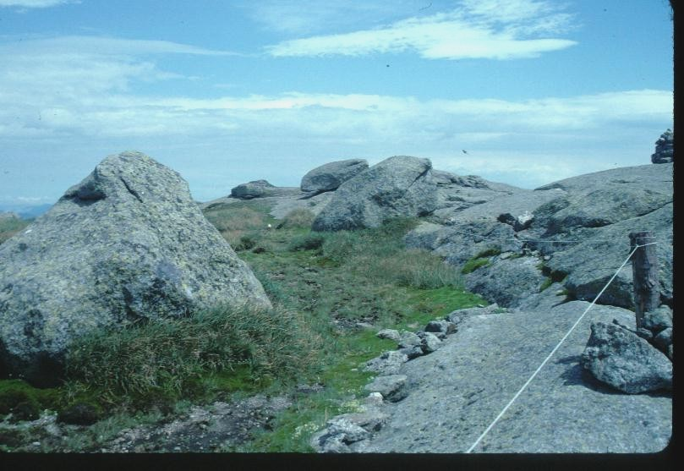
Example Photopoint: MAR-003-LB001-2004
Notes:
2004

Slide 17
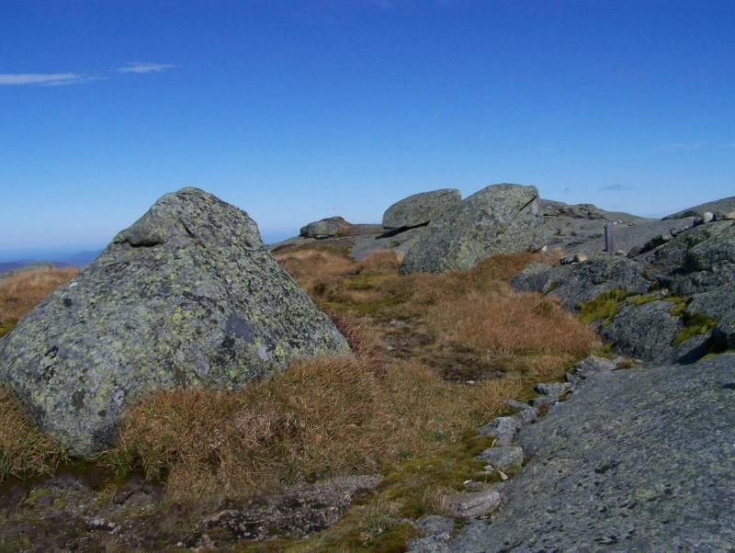
Example Photopoint: MAR-003-LB001-2009
Notes:
2009

Slide 18
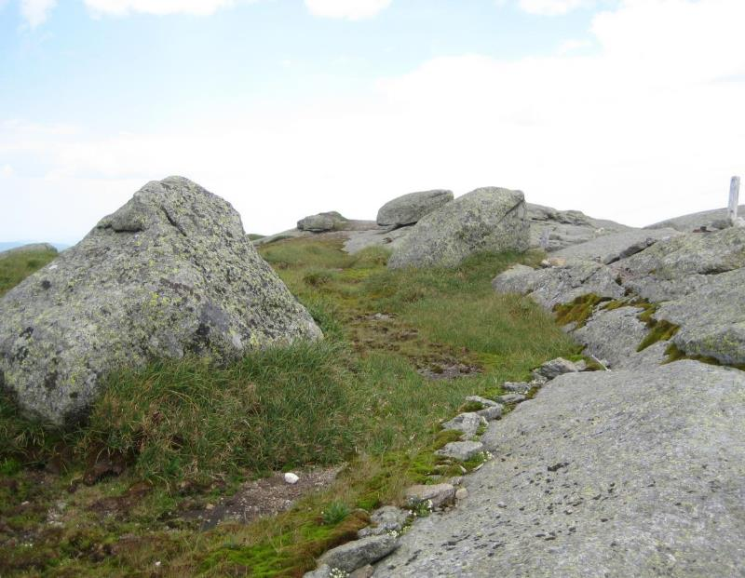
Example Photopoint: MAR-003-LB001-2011
Notes:
2011

Slide 19
So, what can we actually do with these photos?
Project objectives:
Continue the photopoint monitoring
Attempt to use the photos quantitatively
Evaluate the effectiveness of the Summit Steward program
Notes:
So, we’ve got this great library of images from all over the adirondack alpine zone. But what can we DO with them?

Slide 20
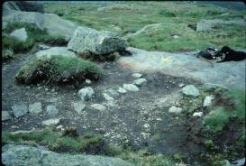
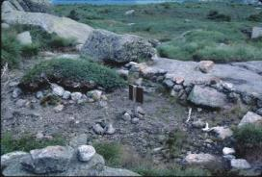
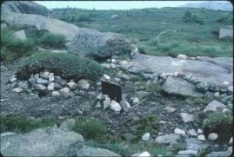
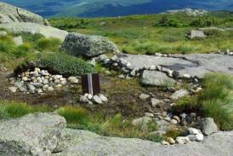
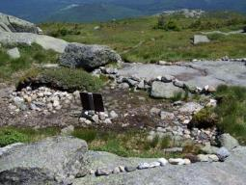
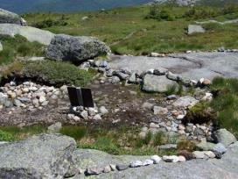
Image Analysis Methods
Best matches from each series were selected by visual estimation.
ALG-011-LB007-1992
ALG-011-LB007-1999
ALG-011-LB007-2004
ALG-011-LB007-2008
ALG-011-LB007-2009
ALG-011-LB007-2011d
Notes:
So, in the summer op of 2009 we re-took 40 of the 50 photopoints. In order to use the photos, first I had to process and analyze the images
Best matches from each series were selected by visual estimation.– This starts to get trickier in the new digital age where we may have as many as 7 or 8 photos taken with slightly different zooms or angles to choose from. I’d like to recognize and thank Seth Jones for his assistance during this phase of the project!
All images were digitized, using either a high-resolution digital scanner, developing directly to disk, or downloading from digital camera.

Slide 21

Baseline image

Slide 22
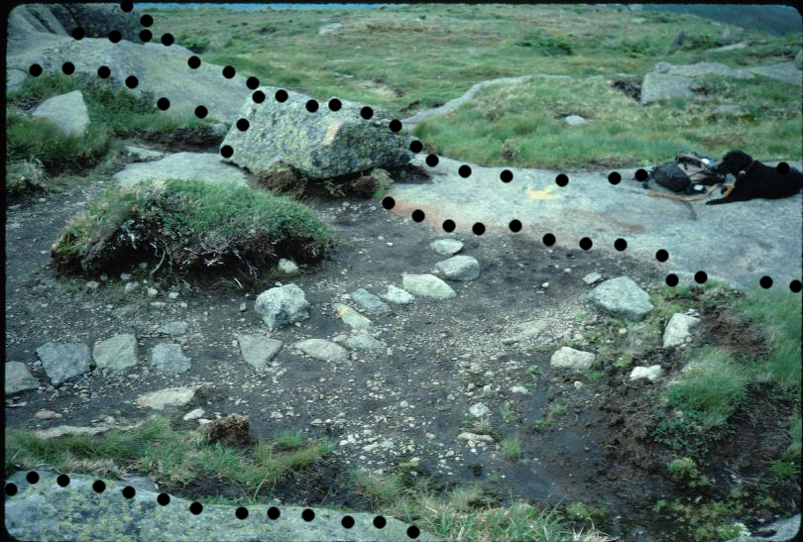
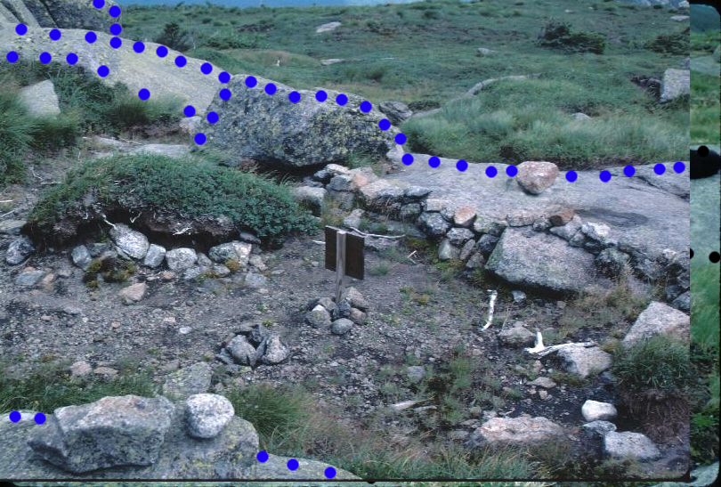
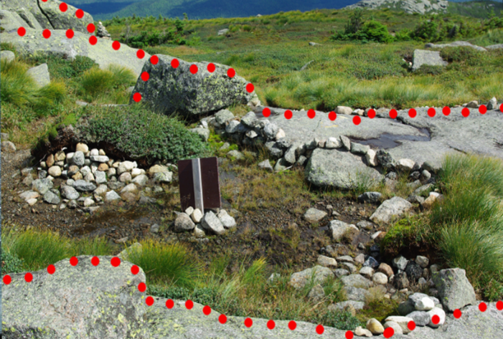
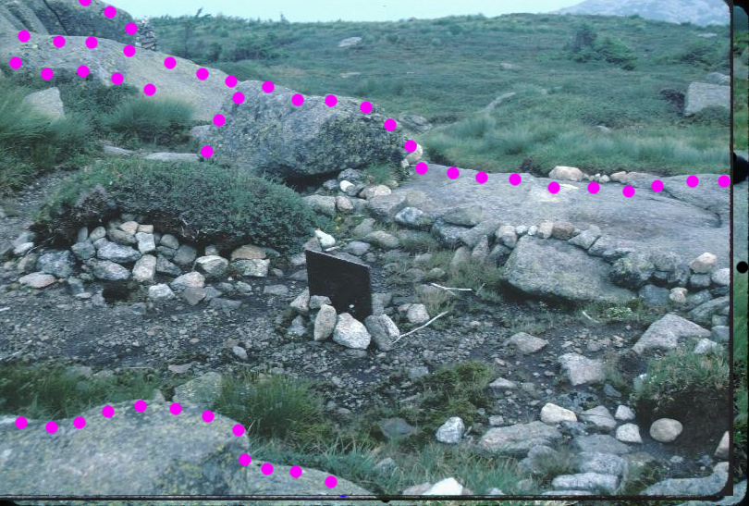
Image Analysis Methods
Notes:
What you see here is the baseline image from 1992. I’ve drawn in the marks on prominent features that don’t move (such as large erratics, bedrock, and the like), to help line the photos up
Here’s the next image in the series, from 1999. You can see I’ve done the same thing here. If your image recollection is particularly good, you may already see some changes in this image compared to the last one.
2004
And 2009

Slide 23
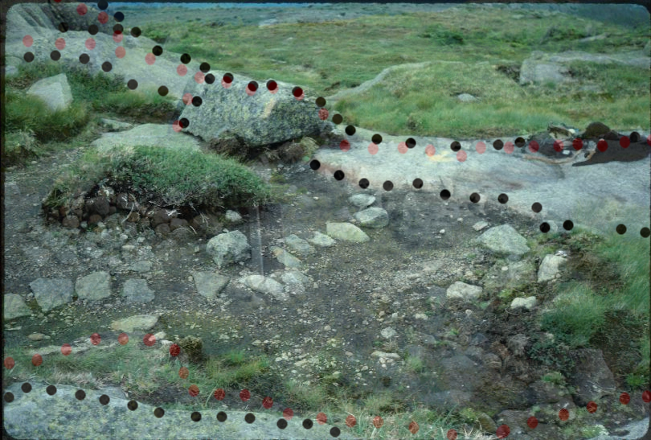
Image Analysis Methods
Notes:
Now is where the fun really begins. Images from each photopoint were opened as layers of a single file, using the GNU Image Manipulation Program (GIMP).
Once they were layered, I played with the transparency of the images in order to get them properly lined up. Here you see the baseline image from 1992 with the 2009 image coming in on top. The 2009 image is 75 percent transparent, so it appears as a ghost image

Slide 24
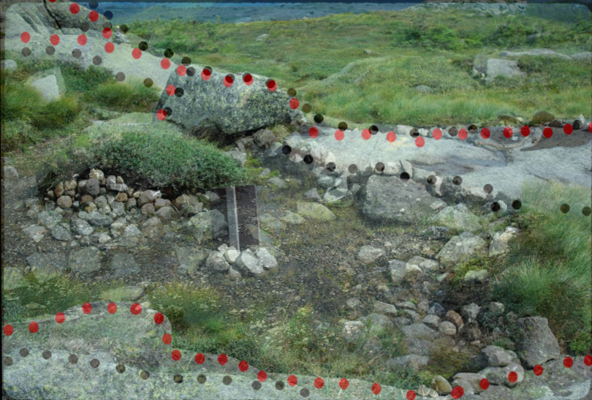
Image Analysis Methods
Notes:
Here we have the 2009 image at about 50% transparency. This is the point where I’d work to line the two images up as precisely as possible.

Slide 25
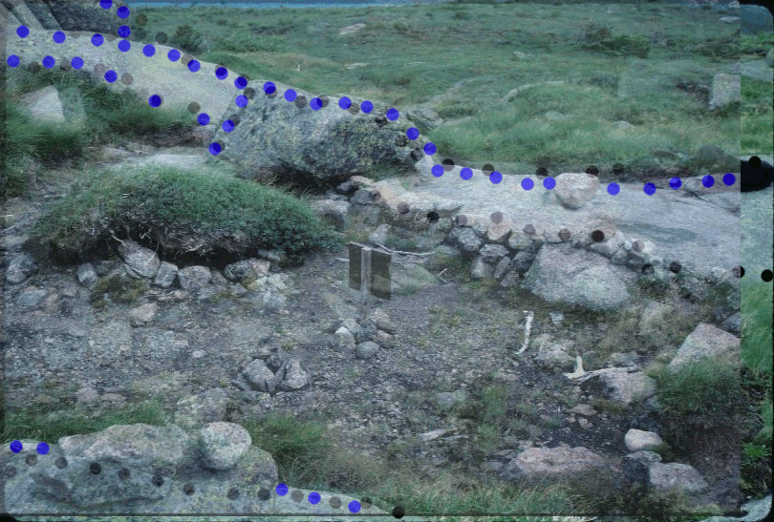
Image Analysis Methods
Photopoint ALG 011 in GIMP, showing baseline image at 100%, 1999 image superimposed at 50% transparency.
Notes:
Once everything was lined up, I superimposed a 120 x 120 pixel grid square on the image and did a visual estimation of percent cover in 3 categories bare rock, vegetation, and exposed soil for each grid square.
Analysis of images themselves is challenging. Without correction for the distortion in depth of field, it is difficult to quantify change. However, as each retake has the same focal length and shows the same image, analyzing the change in the percent of cover visible is possible.

Slide 26
Image Analysis Methods
Point | Year | % Photocover ROCK | % Photocover SOIL | % Photocover VEG
ALG-011-LB007 | 1992 | 35.48 | 44.35 | 20.16
ALG-011-LB007 | 1999 | 39.81 | 31.48 | 28.70
ALG-011-LB007 | 2004 | 49.17 | 23.33 | 27.5
ALG-011-LB007 | 2008 | 48.39 | 11.29 | 40.32
Compiled % Photo cover for ALG 011
Notes:
Gridquare values were averaged to provide a single figure for each year in each of the coverage classes. In order to determine change, Baseline photocover values were subtracted from most recent photocover values and divided by time lapse.
So, I was able to get some kind of quantitative information from the photographs. But this alone doesn’t answer the question of whether the steward program is effective.

Slide 27
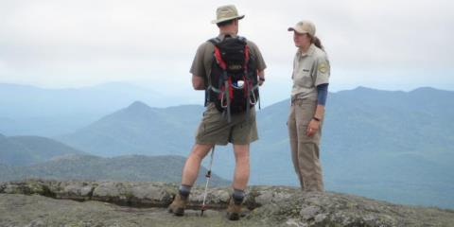
Evaluating the Steward Program
If the steward program is effective, we’d expect to see recovery from trampling in the alpine areas
  AND
We’d expect that recovery to be different on peaks with a steward versus peaks without a steward
Notes:
In order to evaluatate our effectiveness, I have to see recovery (which I define for this project as an increase in vegetation and a decrease in bare rock.) AND that recovery has to be different on stewarded vs non stewarded peaks

Slide 28
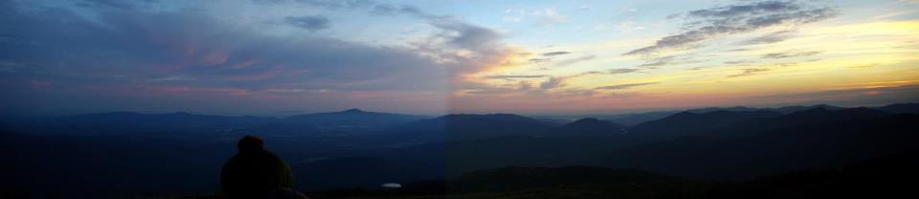
Stewarded Peaks:
  Marcy
  Algonquin
Non-Stewarded Peaks:
  Cascade
  Colden
  Dix
  Gothics
  Skylight
  Whiteface
  Wright
Photo: Brendan Wiltse
Notes:
Now, in order to evaluate the effectiveness of the steward program, mountains were grouped into two categories (steward presence—Algonquin and Marcy, steward absence—Cascade, Colden, Dix, Gothics, Skylight, Whiteface, Wright). In this instance, Stewarded refers to the peaks that have had a 7 day a week steward presence since the beginning of the program. Non-stewarded are all other peaks.

Slide 29
Results
Vegetation, rock, and soil percent change over time with mean, standard deviation, and p-values for stewarded and non-stewarded peaks (1962-2009).
 | Mean Stewarded | Mean Non-Stewarded | Standard Deviation Stewarded | Standard Deviation Non-Stewarded | p-value (t-test, two sample, one tail, equal variances)
Vegetation | .00701 | .00173 | .00942 | .00829 | .01827
Rock | -.00076 | .00366 | .00691 | .007 | .01416
Soil | -.00624 | -.0054 | .008 | .00736 | .34722
There was a significant difference in changes in vegetation and bare rock on stewarded versus non-stewarded summits.
This suggests that Summit Stewards aid in alpine recovery.
Notes:
So, in order to determine whether the steward program is effective, I grouped information from stewarded and non-stewarded peaks and evaluated the difference and found that
There was a significant difference in recovery from human trampling in alpine areas on stewarded versus non-stewarded summits.

Slide 30
Results: Vegetation
The increase in vegetation and decrease in rock over time suggest that alpine areas subject to human trampling are recovering.

Slide 31
Results: Rock

Slide 32
Results: Soil
Notes:
The lack of significant results in the category of bare soil was expected. This category reveals the least information about the nature of change occurring on the summits; bare soil can either be lost to erosion, revealing bare rock, or it can be colonized by vegetation, showing up in the vegetation category.

Slide 33
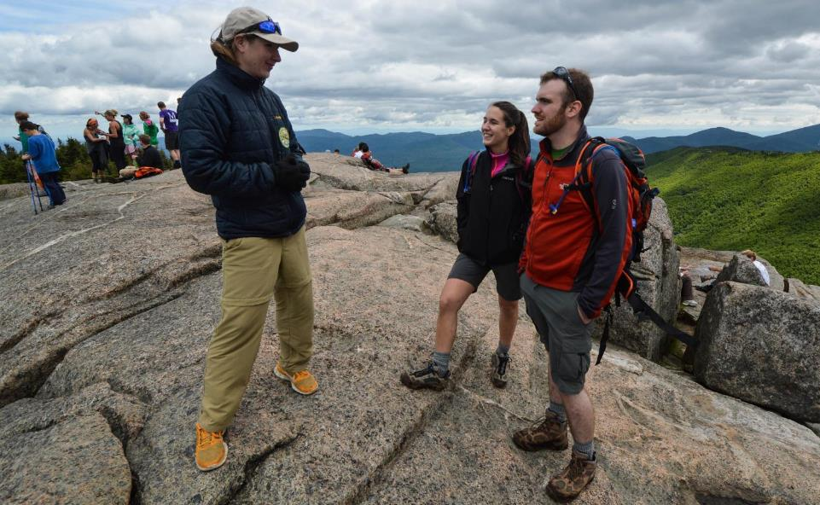
Why are stewards effective?

Slide 34
Summit Steward Contacts, 1990-2016
Total: 446,614

Slide 35
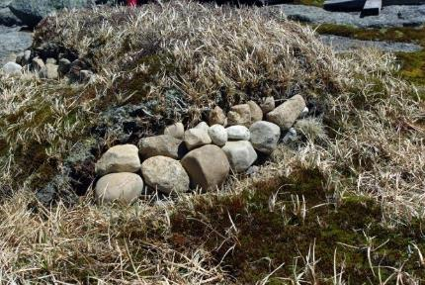
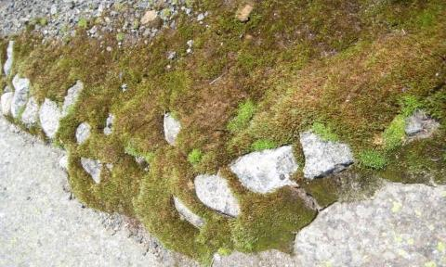
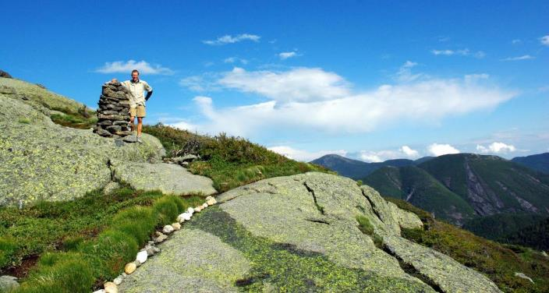
Photo: Brendan Wiltse
Photo: Brendan Wiltse
Notes:
Here are a few steward trail projects: rock packing in the upper left to prevent erosion, a Steward standing next to a newly constructed cairn with scree wall in foreground below, and upper right, a scree wall where the vegetation has grown over the rock.

Slide 36
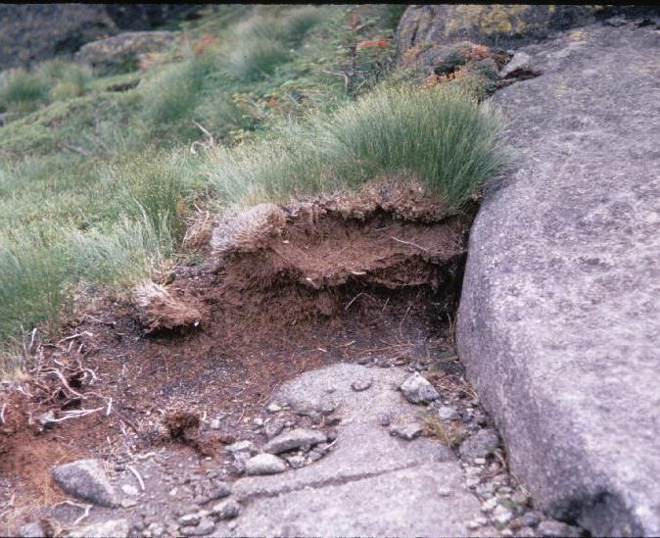
Photopoint: ALGONQUIN 002 -EK038-1966
(Stewarded)
Notes:
Here are a few more photopoint series

Slide 37
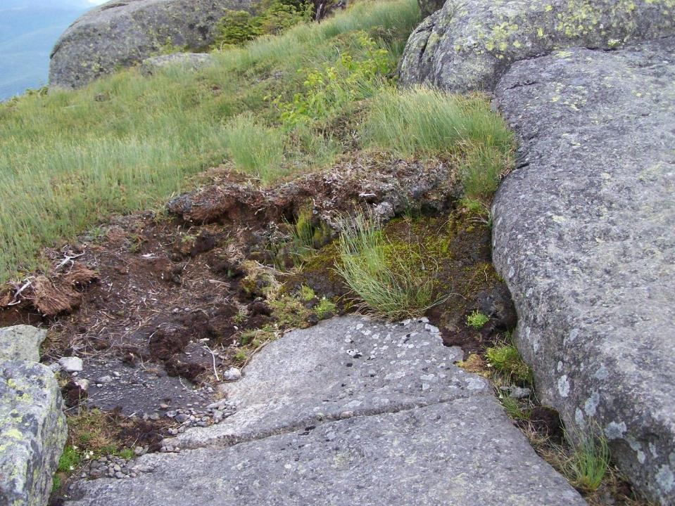
Photopoint: ALGONQUIN 002 -EK038-2009
(Stewarded)

Slide 38
Photopoint: CASCADE 003 -EK003-1966
(Non-stewarded)

Slide 39
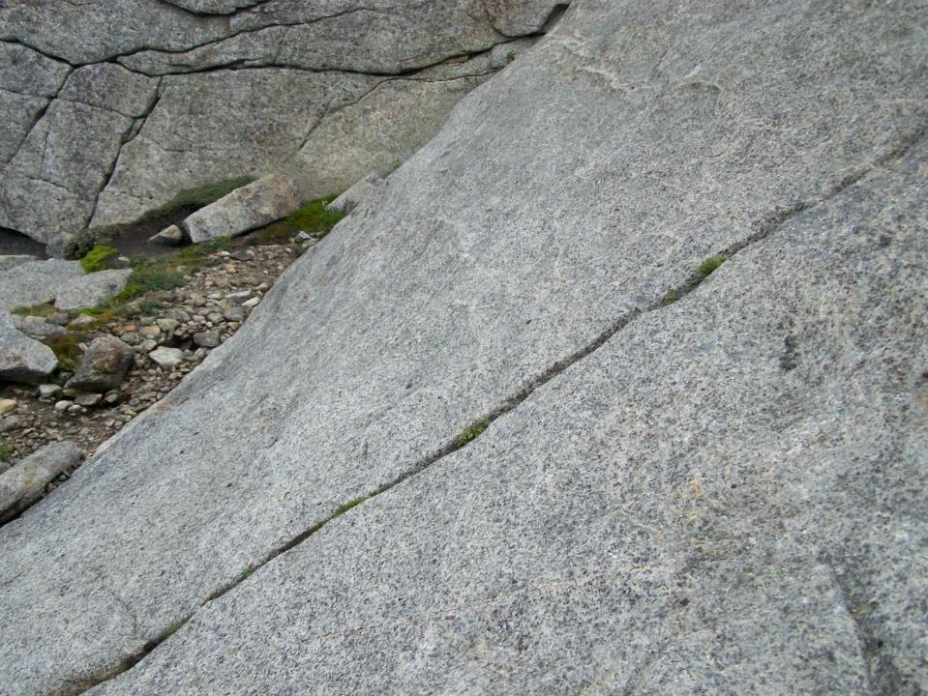
Photopoint: CASCADE 003 -EK003-2009
(Non-stewarded)

Slide 40
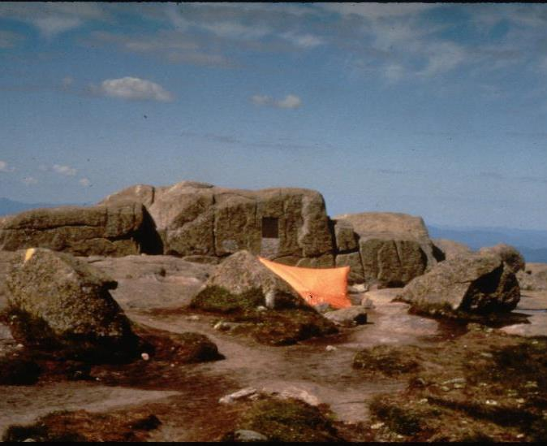
Photopoint: MARCY 002-EK126-1981
(Stewarded)

Slide 41
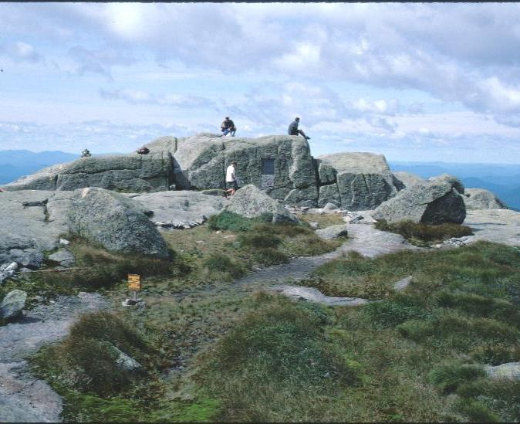
Photopoint: MARCY 002-EK126-1999
(Stewarded)

Slide 42
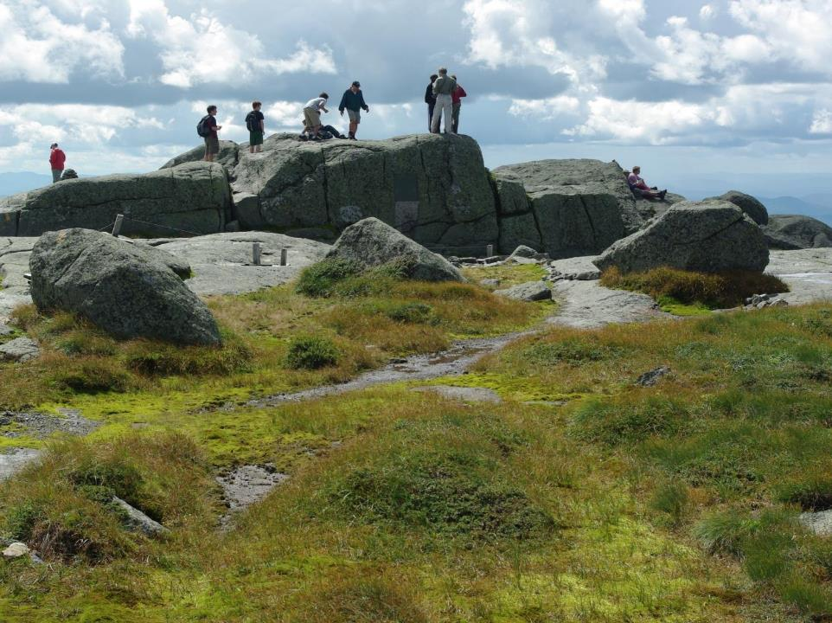
Photopoint: MARCY 002-EK126-2008
(Stewarded)

Slide 43
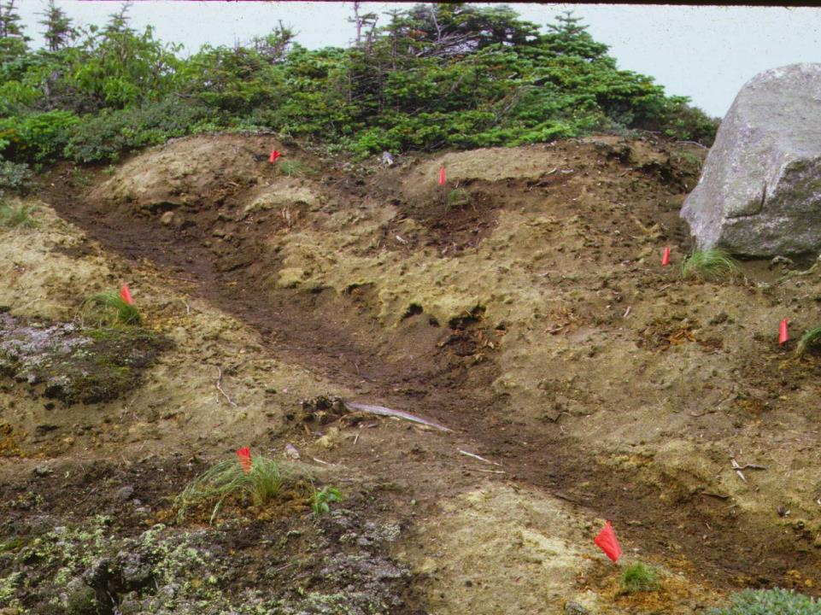
Photopoint: DIX 001-HP32-1966
(Non-stewarded)

Slide 44
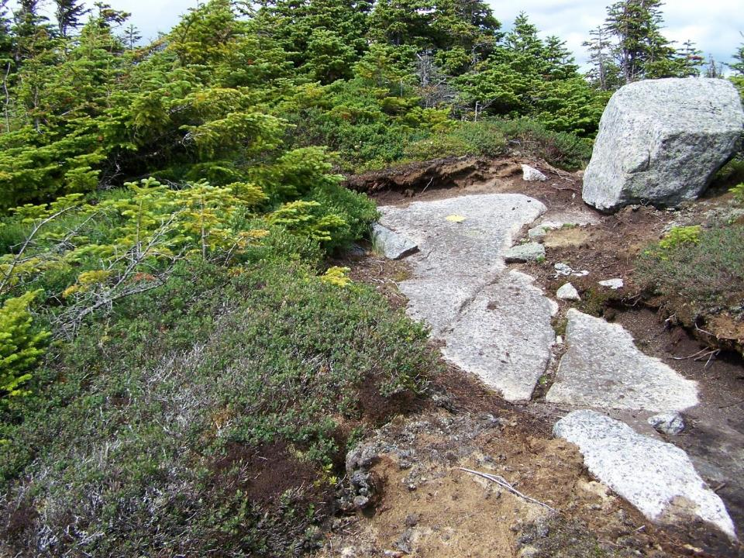
Photopoint: DIX 001-HP32-2009 (digital camera)
(Non-stewarded)

Slide 45
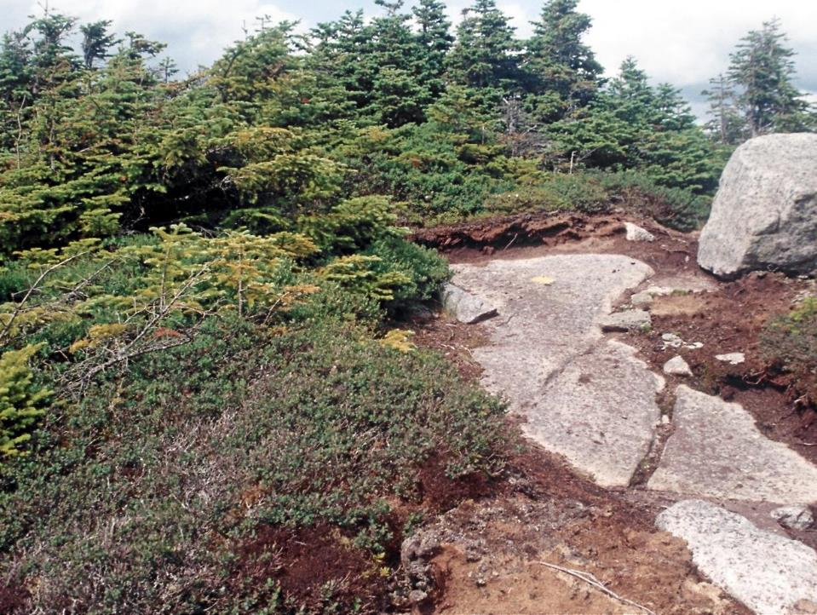
Photopoint: DIX 001-HP32-2009 (film camera)
(Non-stewarded)

Slide 46
Photopoint: ALGONQUIN 013- HP58
(Stewarded, showing original Ketchledge revegetation in process)

Slide 47
Photopoint: ALGONQUIN 013- HP58 -1999
(Stewarded)

Slide 48
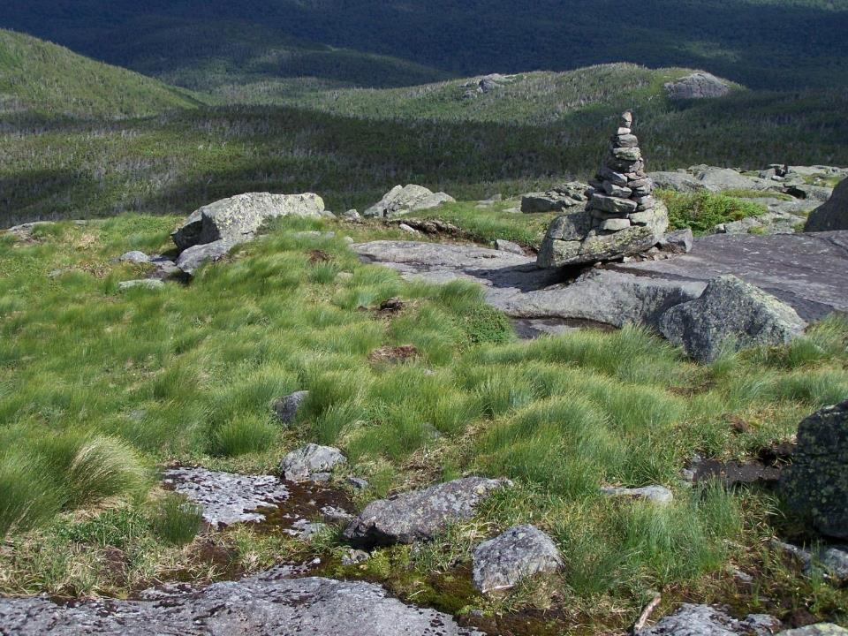
Photopoint: ALGONQUIN 013- HP58-2007
(Stewarded)

Slide 49
Project objectives:
Continue the photopoint monitoring
  Photopoints were retaken in 2009, 2010, 2011, 2013, 2015
Attempt to use the photos quantitatively
  Relative change (% photo cover)
Evaluate the effectiveness of the Summit Steward program
  These results suggest that the presence of a Summit Steward positively impacts alpine recovery

Slide 50


Slide 51
Limitations with this methodology
Only looks at areas of human trampling impact, does not answer what’s happening in non-trampled areas
Inherent subjectivity of ocular analysis
No way to account for Ketch’s revegetation efforts
Oversimplification of stewarded vs. non-stewarded
Notes:
So, of course there are limits to this type of analysis.
A couple of the big ones are that this only looks at areas that have been impacted by human trampling. This doesn’t provide any information about what has happened in non-trampled areas.
Any analysis that is done by the human eye has some subjectivity in it. Further, a classification simply of vegetation doesn’t answer the question of whether these are alpine or non-alpine plants.
Dr. Ketchledge’s revegetation work in the Adirondacks changed what some of these mountains (Algonquin in particular) looked like. This analysis doesn’t actually allow us to tease out the effects of his work.
Since I’m not a scientist and I don’t work with statisticians, I had to keep the analysis that I did relatively simple. Therefore, I simplified the stewarded and non-stewarded categories- some of those peaks are very rarely stewarded, some stewarded regularly but only in the last few years
It’s a simple analysis– more complex statistics reveal a more complicated story

Slide 52
Advantages of this methodology
It’s simple and most of the software involved is free and easy to use
  A program with a limited budget and without scientists on staff can do this!
Photographs for use as baseline photos are readily available– most programs have these photos already
Notes:
Simple does have some advantages, though– this is an analysis method that anyone can do (with patience)!

Slide 53






Thank you!
Dr. Elena Traister, Dr. Tim Howard, Kayla White, Wes Lampman, Seth Jones, Brendan Wiltse, Melinda Scott, Caroline Scully, Elizabeth Berg, Summit Steward crews 2004, 2009, 2010, 2011, 2013, 2015

Slide 54


